Slide 2
Spring Security
Spring security is a farmwork that provides authentication, authorization and protection against common attacks like CSRF.
Authentication — It is the process of verifying the identity of a user or entity.
Authorization — It is the process of determine what actions or resourses a user or system is permitted to access after they have been successfully authenticated.

Slide 3
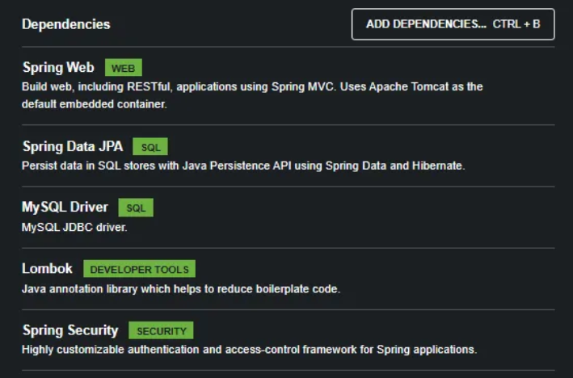

Slide 4
Basic Authentication and Authorization.
Before moving to basic authentication, we need to see the default authentication mechanism of Spring Security. When you add a spring-security dependency by default, spring security provides a default security mechanism.

Slide 5
First, comment on your JPA and MySql driver dependencies in your pom.xml file. Otherwise, you cannot start your application.
We don’t need those dependencies now.

Slide 6
@RestController @RequestMapping("api/employees") public class EmployeeController { @GetMapping public String getAllEmployees(){ return "You Received All Employees List"; } @PostMapping public String saveEmployees(){ return "You saved a Employee"; } @PutMapping public String updateEmployees(){ return "You updated a Employee"; } }

Slide 7
Let’s do basic authentication.
1 — Add SecurityConfig.java class in your Config package.

Slide 8
@Configuration @EnableWebSecurity @EnableMethodSecurity public class SecurityConfig { @Bean public PasswordEncoder passwordEncoder(){ return new BCryptPasswordEncoder(); } @Bean public SecurityFilterChain securityFilterChain(HttpSecurity http) throws Exception{ http.csrf().disable() .authorizeHttpRequests((authorize)->{ authorize.requestMatchers("api/v1/**").permitAll(); authorize.anyRequest().authenticated(); }).httpBasic(Customizer.withDefaults()); return http.build(); } @Bean public UserDetailsService userDetailsService(){ UserDetails john = User.builder() .username("john") .password(passwordEncoder().encode("john")) .roles("USER") .build(); UserDetails sam = User.builder() .username("sam") .password(passwordEncoder().encode("sam")) .roles("ADMIN") .build(); return new InMemoryUserDetailsManager(john,sam); } }

Slide 9
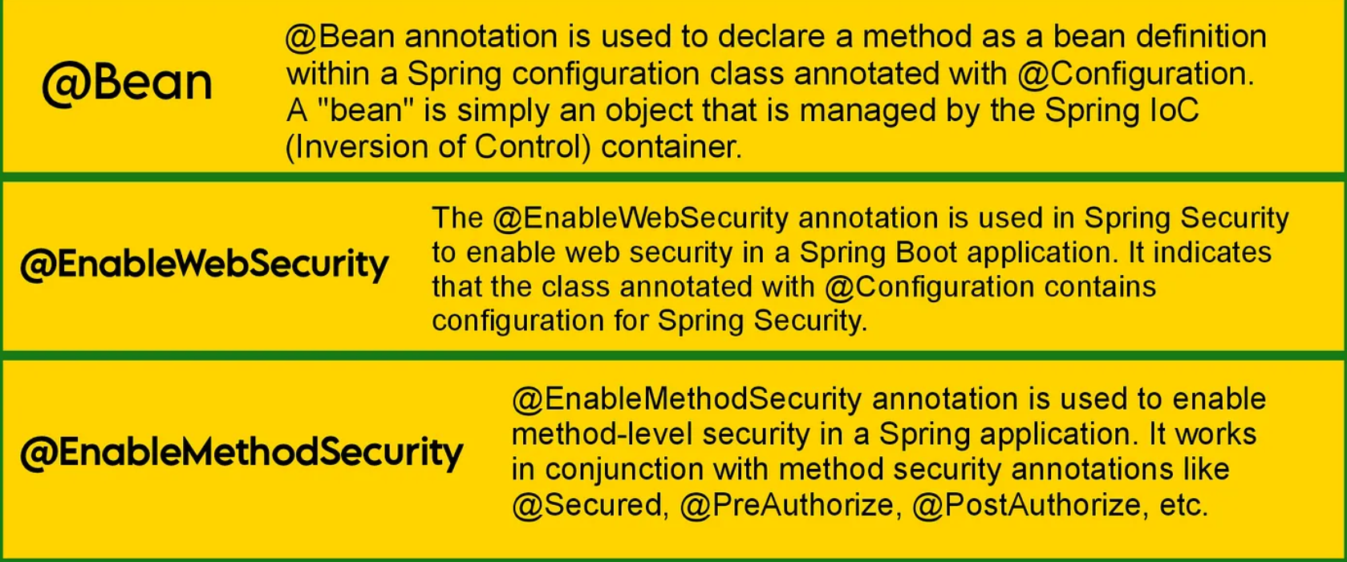

Slide 10
PasswordEncoder interface is used to encode the password and store it securely. The BCryptPasswordEncoder class implementation uses the bcrypt algorithm to hash the passwords.
SecurityFilterChain is a class provided by Spring Security. It is responsible for handling the security aspect of receiving HTTP requests.
csrf (Cross-Site Request Forgery) is a security feature that prevents malicious websites from performing actions on behalf of authenticated users.
authorizeHttpRequests specify authorization rules.
here, we used http basic ( httpBasic()). (Also, you can use Form Based Authentication. Then you need to add formLogin( ) instead httpBasic( ))
UserDetailsService interface is used to retrieve user-related data during the authentication process.
InMemoryUserDetailsManager is an implementation of the userDetailsService interface. It is used when you want to store user details in memory, typically for testing or similar applications where a full database isn’t necessary.

Slide 11
2 — Then you need to add some annotations to the EmployeeController.java class.

Slide 12
@RestController @RequestMapping("api/v1/employees") public class EmployeeController { @GetMapping @PreAuthorize("hasRole('ROLE_USER') or hasRole('ROLE_ADMIN')") public String getAllEmployees(){ return "You Received All Employees List"; } @PostMapping @PreAuthorize("hasRole('ROLE_ADMIN')") public String saveEmployees(){ return "You saved a Employee"; } @PutMapping @PreAuthorize("hasRole('ROLE_ADMIN')") public String updateEmployees(){ return "You updated a Employee"; } }

